Slide 1
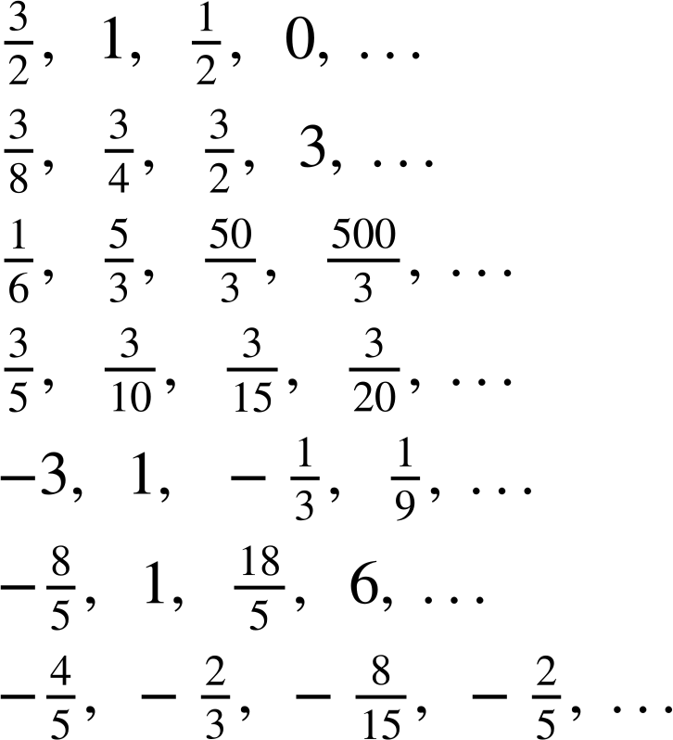
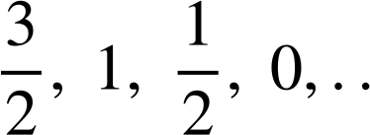
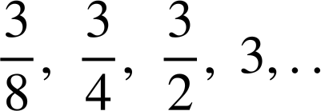
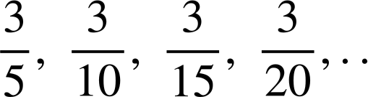
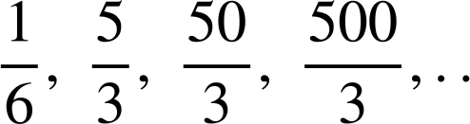
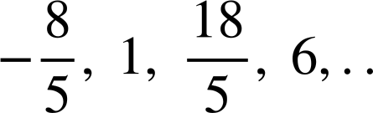
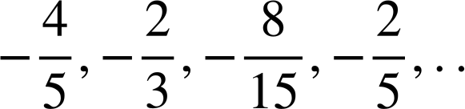
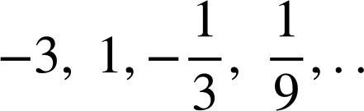
Recognising special number sequences
Task A: Arithmetic and geometric sequences
Sort these sequences into the correct column of the table.
arithmetic | geometric | neither
a) 1, 2, 3, 4, 5,… g) −1, 5, 11, 17, 23,. i) 36, 12, −12, −36,. | b) 3, 9, 27, 81,… c) 0.5, 1, 2, 4,... f) −2, 4, −8, 16,.. j) 13.5, 9, 6, 4, … | d) 1, 1, 2, 4, 7,... e) 1, 2, 4, 7, 11,. h) 18, 35, 52, 68,. k) 12, 6 , 3 , 0, …
1, 2, 3, 4, 5, …
3, 9, 27, 81, ….
0.5, 1, 2, 4, …
1, 1, 2, 4, 7, …
1, 2, 4, 7, 11, …
−2, 4, −8, 16, …
−1, 5, 11, 17, 23, …
18, 35, 52, 68, …
36, 12, −12, −36 …
13.5, 9, 6, 4, …
12, 6 , 3 , 0, …
2) Sort these sequences into the correct column of the table.
arithmetic | geometric | neither
a) g) | b) c) e) | d) f)
a)
b)
c)
d)
e)
f)
g)
3) A sequence starts 2a, 6a, …
a) If the sequence was arithmetic, what would the next three terms be?
10a, 14a, 18a,….
b) If the sequence was geometric, what would the next three terms be?
18a, 54a, 162a, …
c) Continue this sequence in another way, describe the rule you have used.
Many possible answers.

Slide 2

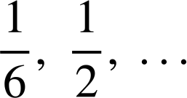


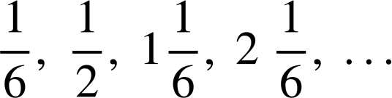


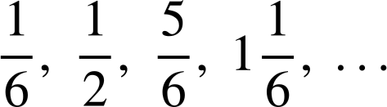
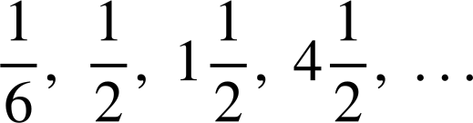



Recognising special number sequences
Task B: Exploring other sequences
1) By working out the pattern, find the next two terms in each sequence.
2, 8, 32, 128, … 512, 2048 Geometric sequence with common ratio ×2
2, 8, 14, 20, … 26, 32, Arithmetic sequence with common difference +6
2, 8, 15, 23, … 32, 42 Quadratic sequence with second difference +1
2, 8, 16, 26, … 38, 52 Quadratic sequence with second difference +2
2, 8, 10, 18, … 28, 46 Add the two previous terms to get the next term
2, 8, 17, 29, … 44, 62 Quadratic sequence with second difference +3
8, 2, 10, 12, … 22, 34 Add the two previous terms to get the next term
8, 2, −4, −10, … −16, −22 Linear sequence with common difference −6
3, 5, 11, 21, … 35, 53 Quadratic sequence with second difference +4
4, 6, 12, 22, … 36, 54 Quadratic sequence with second difference +4
6, 10, 22, 42, … 70, 106 Quadratic sequence with second difference +8
−3, −5, −8, −13, … −21, −34 Add two previous terms to get the next term
−3, −5, −7, −9, … −11, −13 Arithmetic sequence with common difference −2
2, −6, 18, −54, … 162, 486 Geometric sequence with common ratio ×(−3)
1, −7, −10, −8, … −1 11 Quadratic sequence with second difference + 5
−8
−3
+2
+7
+12
+5
+5
+5
+5
2) Aisha, Izzy and Lucas have all created a sequence starting with the terms:
For each question justify your answer.
a) Who has created an arithmetic sequence?
Izzy, common difference
b) Who has created a geometric sequence?
Lucas, common ratio × 3
c) Who has created a quadratic sequence?
Aisha, the sequence then then
common second difference of
Aisha
Izzy
Lucas
Mathematics in Education and Industry.
v2.3

